Slide 1
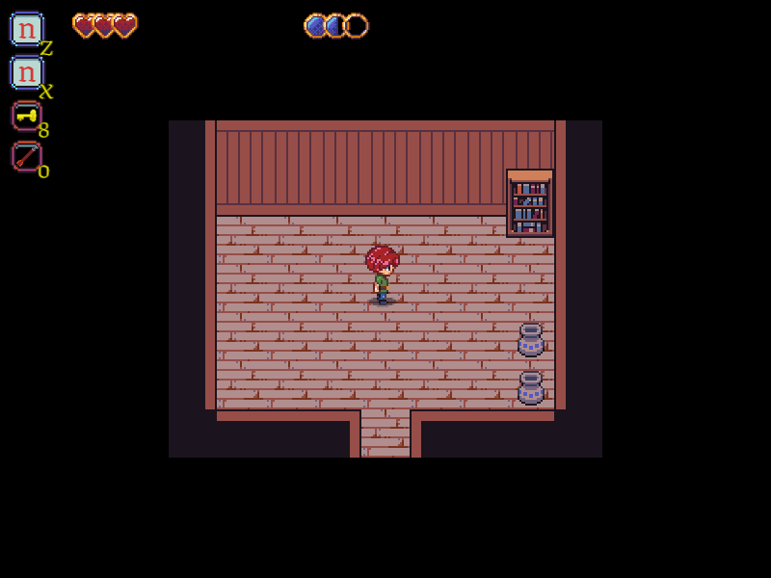
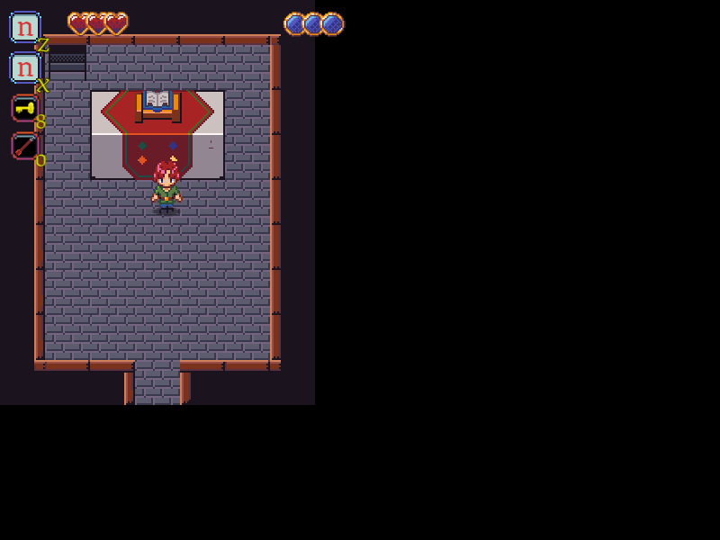
Dagger’s Gate
Pitch Date: 1/31/2021 Today: 4/25/2021 4:00 PM EST
Release Date: 5/23/2021
Team Lead: Vince McKeown 381 Commits total, Week 11

Slide 2
Contributors this week: Kyle Knutson
Added Chill music when in the shop

Slide 3
Contributors this week: Vince McKeown
Added Alchemist NPC
Added Church Altar

Slide 4
Contributors this week: B4ttleCat
Broken Pot

Slide 5
Contributors this week: Tylor Allison
Added Village Elder
UI Fader
Story Line – Intro
Story Line – First Quest
Artwork for Church Interior/Exterior
Expanded Town to include church

